Slide 1
Teen Bullying Pre-COVID and Now Tuesday Talks about Teens June 30, 2020
Andrea Fallick, LCSW, CASAC, CPP
Certified Trainer & Consultant
Olweus Bullying Prevention Program
Director, School Based Services
Student Assistance Services

Slide 2
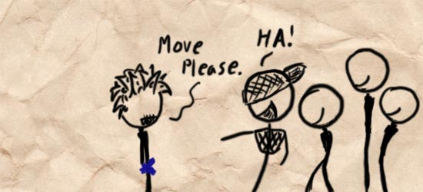
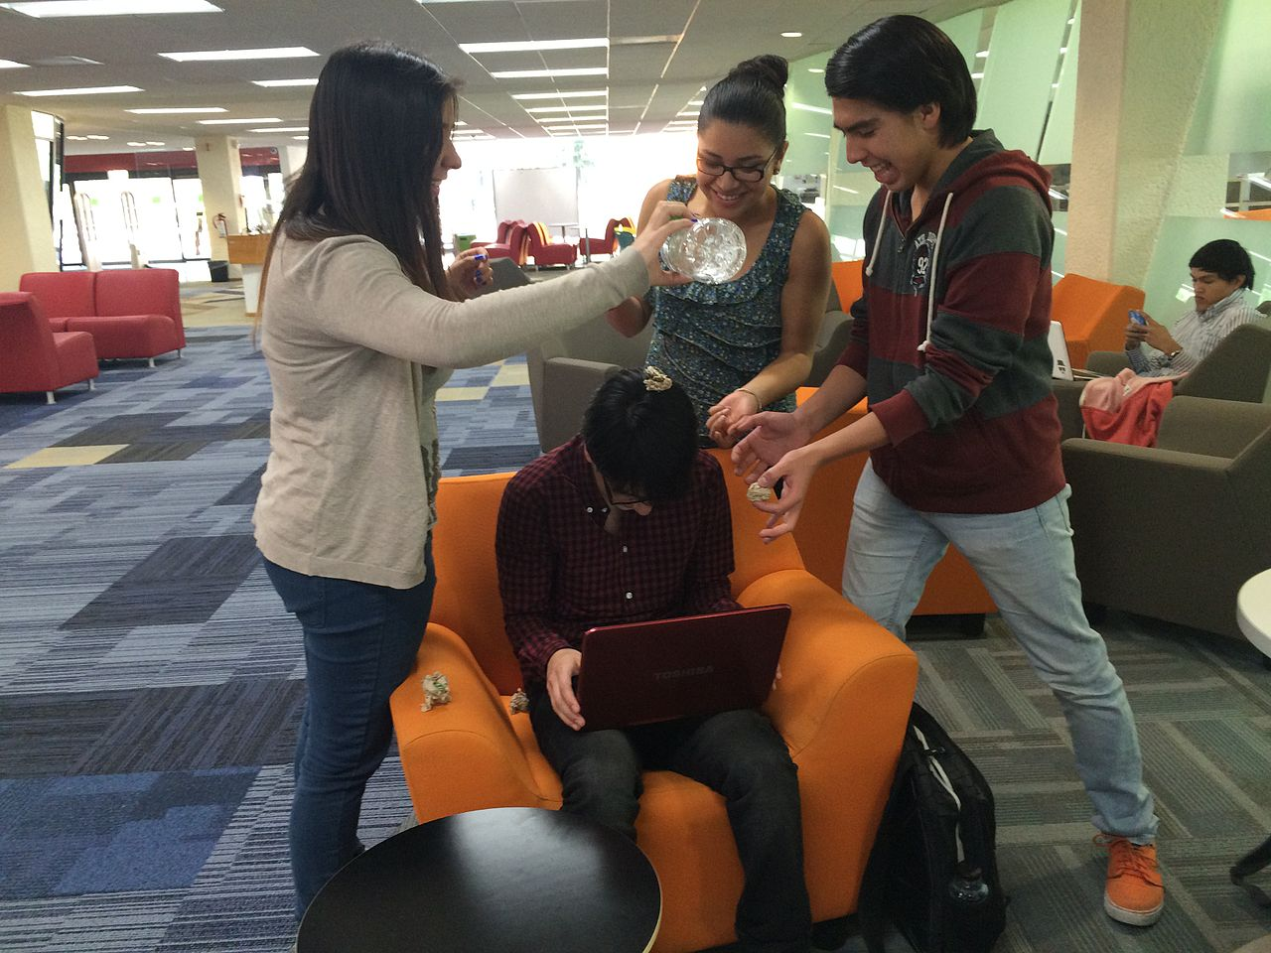
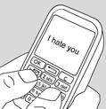
Center for Disease Control Definition
Involves an intentional aggressive behavior
Typically involves a pattern of behavior repeated over time, or has the potential to be repeated
Involves an imbalance of power or strength, that may or may not be observable
The target believes/feels they cannot defend themselves
Verbal Bullying
Cyberbullying
Physical Bullying
Relational Bullying

Slide 3
The Link Between Substance Use and Bullying
Bullied in school/on School Property.
35.2% who reported being bullied on school property report current alcohol use
24.8% who DO NOT report being bullied on school property report current alcohol use
24.0% were bullied on school property report current marijuana use
18.7% who DO NOT report being bullied on school property report current marijuana use
NYS 21% of students report being bullied in school
Electronic Bullying and Current Marijuana Use:
41% of students who report being electronically bullied report alcohol use
24% of students who DO NOT report being electronically bullied report alcohol use
28.6% of students who report being electronically bullied report current marijuana use
15.7% of students who DO NOT report electronic bullying report current marijuana use
NYS, 17.6 % of students had been electronically bullied (counting being bullied through texting, Instagram, Facebook, or other social media) during the 12 months before the survey

Slide 4
Bullying and Depression: The Research Connection
Learned Helplessness
Lack of Control
Hopelessness
Helpless/perception of control
Wounded Self Concept
Exposure to violence in the home
Higher levels of substance use
Centers for Disease Control Youth Risk Behavior Survey 2017 HS students, NYS.
57.8% of students who report being bullied in school report being sad or hopeless
25.2% who DO NOT report being bullied in school report being sad or hopeless
56.6% of students who report being electronically bullied report being sad or hopeless
24.7% who DO NOT report being electronically bullied report being sad or hopeless

Slide 5
What is the Association between Being a Victim of Bully and Anxiety?
There is compelling evidence that anxiety is an outcome of being a target of bullying (Wolke, D, Copeland W.E. 2013)
Victims displayed higher levels of social anxiety than students who were not involved in bullying/cyberbullying. (Coelho & Romao, 2018)

Slide 6
Could There Be a Rise in Cyberbullying since COVID-19?
Reasons why there may be increased risks of cyberbullying
To think there would not be any cyberbullying would be unrealistic
Without data we cannot say for sure

Slide 7
Reasons Why Teens are Reluctant to Acknowledge Being Bullied
Don’t recognize it as bullying
Don’t want to appear weak
Fear retaliation/Fear bullying will get worse
Don’t know how to talk about it
Think adults won’t understand or won’t do anything
Think nothing can be done about it
Concern about family’s response

Slide 8
Warning Signs
Increases/decreases in device use
Emotional responses while on the device
Hiding their screen/device
Avoiding discussion
Social media accounts are shut down or new ones appear
Avoiding social situations, even those that were enjoyed in the past
Becoming withdrawn or depressed, or losing interest in people and activities

Slide 9
When You Find Out Your Teen is being Bullied/Cyberbullied
Remind your teen NOT to respond to hurtful comments or threats
Do not over or underreact
Get the details/Talk it through
Brainstorm solutions
Decrease teen’s isolation
Help reduce the pain associated with victimization

Slide 10
Teens Bullying Others
Bullying others associated with:
Get into frequent fights
Be injured in a fight
Steal, vandalize property
Drink alcohol, smoke
Be truant, drop out of school
Report poorer academic achievement

Slide 11
When You Find Out Your Teen is Bullying Others
Take it Seriously
Have a conversation and talk out the situation
Role play tough situations
Self Reflection

Slide 12
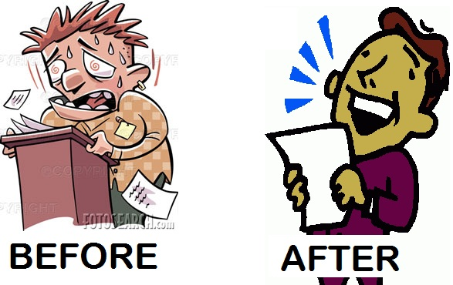
ABC PLEASE
Accumulate Positive Experiences
Short Term: Do pleasant things that are possible now
Long Term: Make changes so positive things will happen more offer
Build Mastery
Do things that make you feel competent and effective to counter act helplessness and hopelessness
Cope Ahead of Time
Rehearse a plan ahead of time so you are prepared to cope skillfully

Slide 13
Safety Tips for Teens to Prevent and Stop CYBERBULLYING
Don’t share your passwords with anyone
Don't respond to any hurtful messages or posts
Don't forwarding any hurtful messages
Save, screenshot and print out all the messages as proof of cyberbullying.
Talk to a friend
If you are being bullied, tell a trusted adult immediately to get help.
Use the account and privacy settings
Pause before you post.

Slide 14
“The world breaks everyone, and afterward some are strong at the broken places” Ernest Hemmingway

Slide 15
Resources
Stopbullying.gov
Cyberbullying Research Center
Common Sense Media
Child Mind Institute
Connect Safety
Olweus Bullying Prevention Program, Clemson University
GLSEN
Center for Disease Control, YRBS, 2017
Andrea Fallick, LCSW, CASAC, CPP
Andrea.Fallick@sascorp.org
914-332-1300

